Slide 1
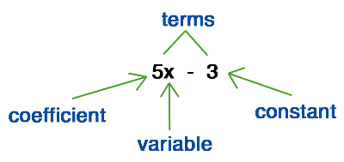
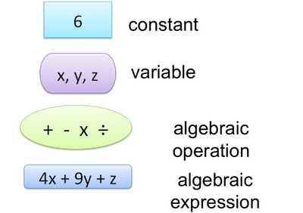
My Algebra Interactive Notebook
Name
Class 9-9
Teacher Mr Evans
Term 1 Semester 1
1

Slide 2
Contents
Glossary or Formula Page
Page
Date
Description
2
3

Slide 3
Tasks
24
7
30
Essential Question
Questions
Notes
Summary

Slide 4
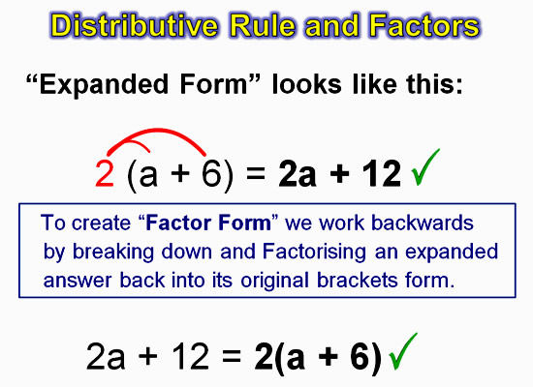
24
7
30
Date
Factorising
EQ – How do we factorise an algebraic expression using HCF?

Slide 5
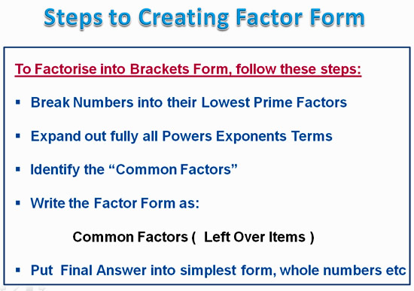
24
7
30
Date
Factorising
EQ – How do we factorise an algebraic expression using HCF?

Slide 6
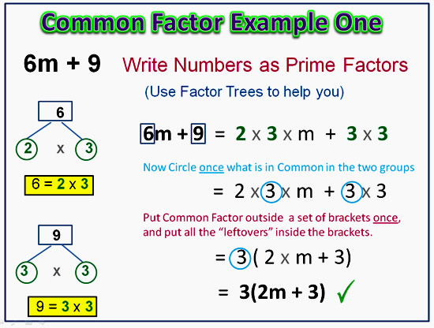
24
7
30
Date
Factorising
EQ – How do we factorise an algebraic expression using HCF?

Slide 7
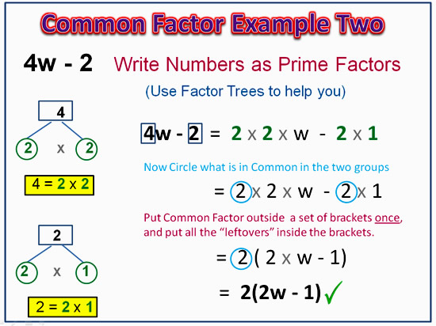
24
7
30
Date
Factorising
EQ – How do we factorise an algebraic expression using HCF?

Slide 8
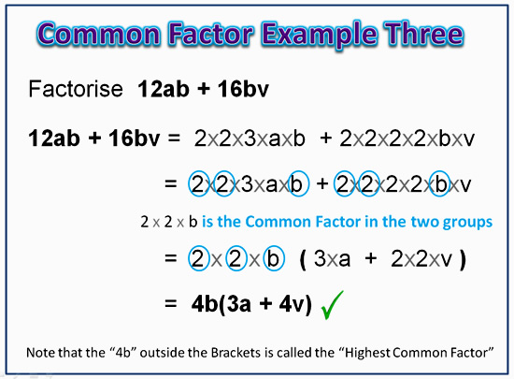
24
7
30
Date
Factorising
EQ – How do we factorise an algebraic expression using HCF?

Slide 9
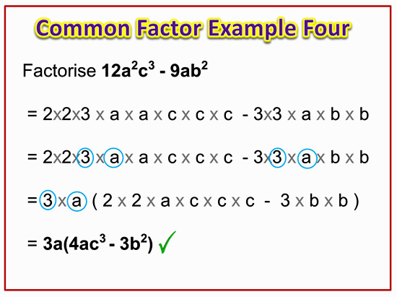
24
7
30
Date
Factorising
EQ – How do we factorise an algebraic expression using HCF?

Slide 10
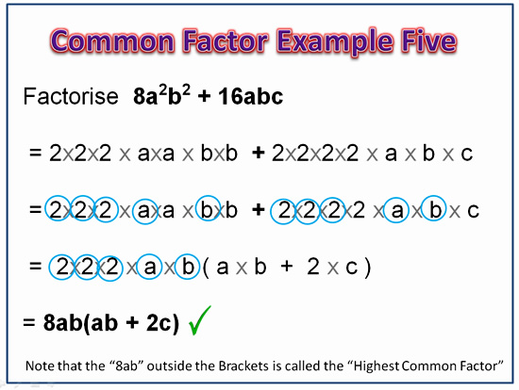
24
7
30
Date
Factorising
EQ – How do we factorise an algebraic expression using HCF?

Slide 11
Task
Complete Exercise 2.4 on Page 20

Slide 12
Notes Review
24, 7 ,30
Date
Title
Essential question
Notes complete
Notes complete with colour and diagrams
Questions completed
Contents page filed in
Formula page filled in

Slide 13
Homework
Review your notes and write a summary answering the essential question.

